Slide 1
IoT : ASSIGNMENT
SUBMITTED BY: UDITA DUBEY
DATE:28-7-2025

Slide 2
TOPIC: LOGIC POWER SUPPLY?
A logic power supply is a type of power source that provides the low-voltage DC power needed to operate digital electronic circuits like microcontrollers, processors, and logic gates. These power supplies are designed to deliver a stable and regulated voltage to ensure proper functioning of digital devices.

Slide 3
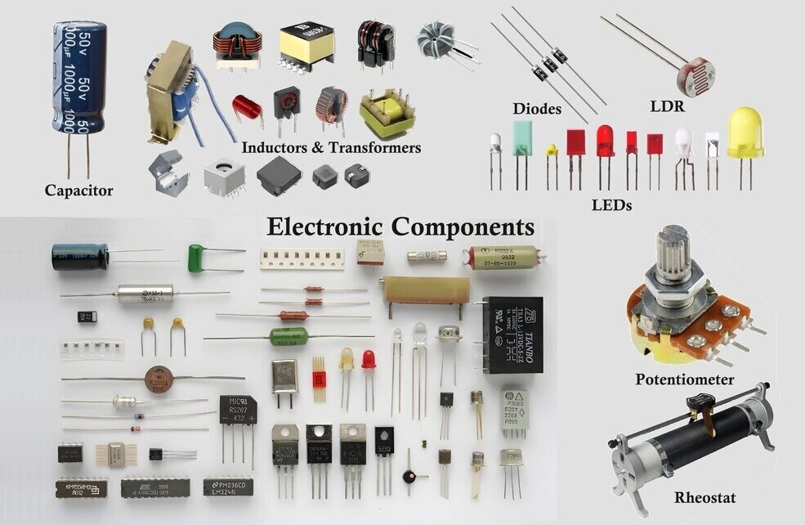
BASIC ELECTRONIC COMPONENTS

Slide 4
Power Supply or Transformer
Polarized Capacitor–( Capacitance: 2200 microfarad and voltage rating 30 volt)
Diode(4 required)
Voltage Regulator IC – LM7805
Resistor (1K)
LED
Breadboard
BASIC COMPONENTS REQUIRED:

Slide 5
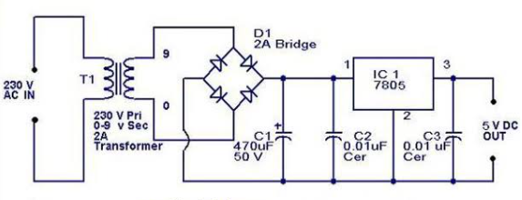
BLOCK DIAGRAM
230V-AC TRANSFORM INTO 5V DC
This block diagram shows the conversion of 230V AC into a regulated 5V DC output using a step-down transformer, bridge rectifier, filtering capacitor, and LM7805 voltage regulator.

Slide 6
Dual Power Supply Components Required:
1.Power supply or Transformer
2. Polarized capacitor – (1 Capacitor with Capacitance 2200 microfarad and Voltage rating 30 volt and 3 Capacitors with Capacitance 100 microfarad)
3.Diode (4 required)
4.Voltage Regulator IC (LM7805 (5V) and LM7812 (12V))
5.Resistor (1K)
6.LED (2)
7.Breadboard

Slide 7
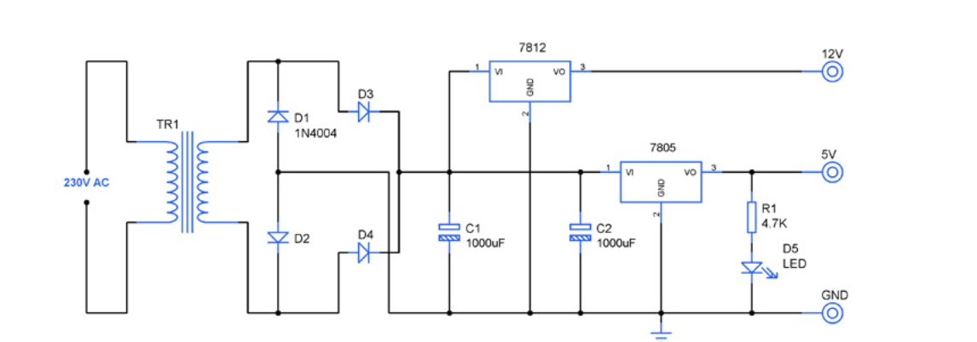
This version of the power supply provides both 5V and 12V DC using LM7805 AND LM7812 IC’s. Useful for circuits requiring multiple logic levels.
BLOCK DIAGRAM
Dual power supply 12V 5V
NOTE: This block diagram is taken from internet as reference. The components shown may differ from the ones used in actual circuit.

Slide 8
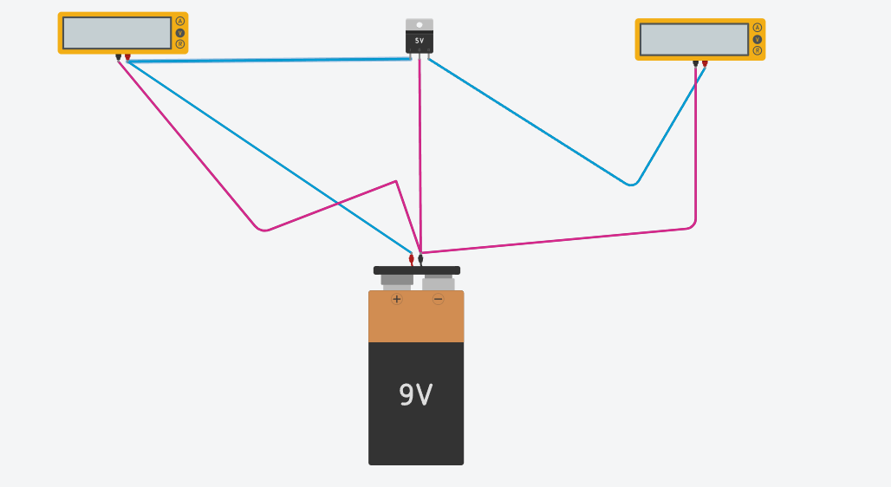
VOLTAGE REGULATOR IC LM7805
BEFORE STIMULATION:

Slide 9
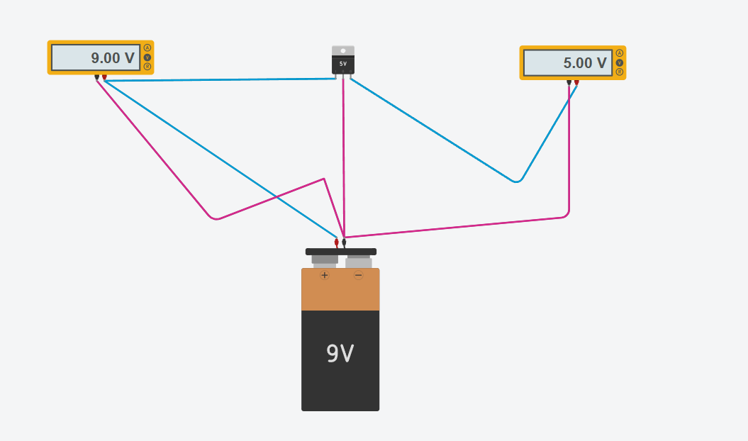
AFTER STIMULATION: Output:

Slide 10
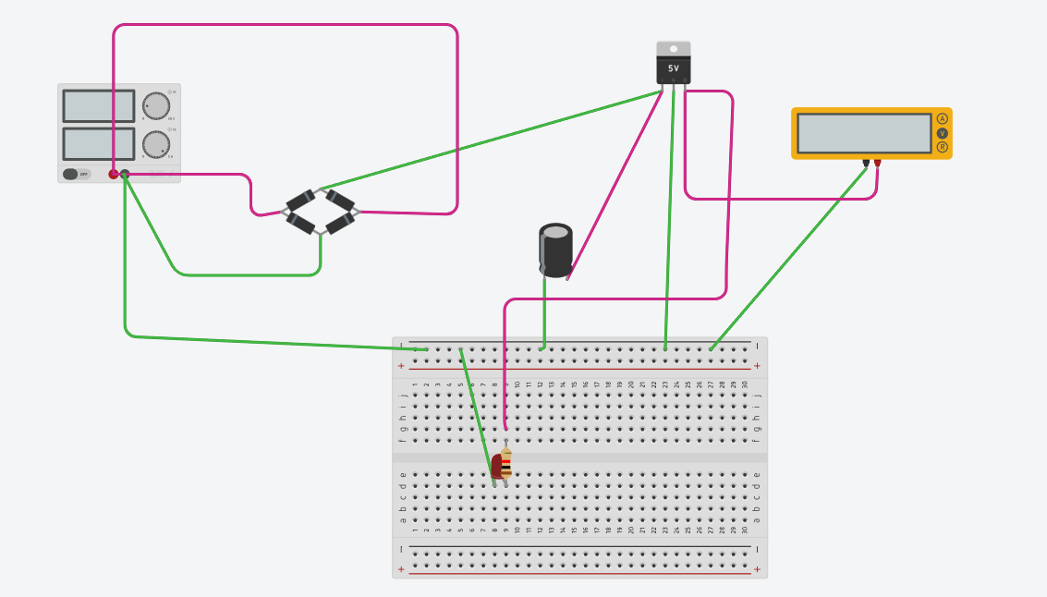
LOGIC POWER SUPPLY
CIRCUIT DIAGRAM: Made from Tinkercad

Slide 11
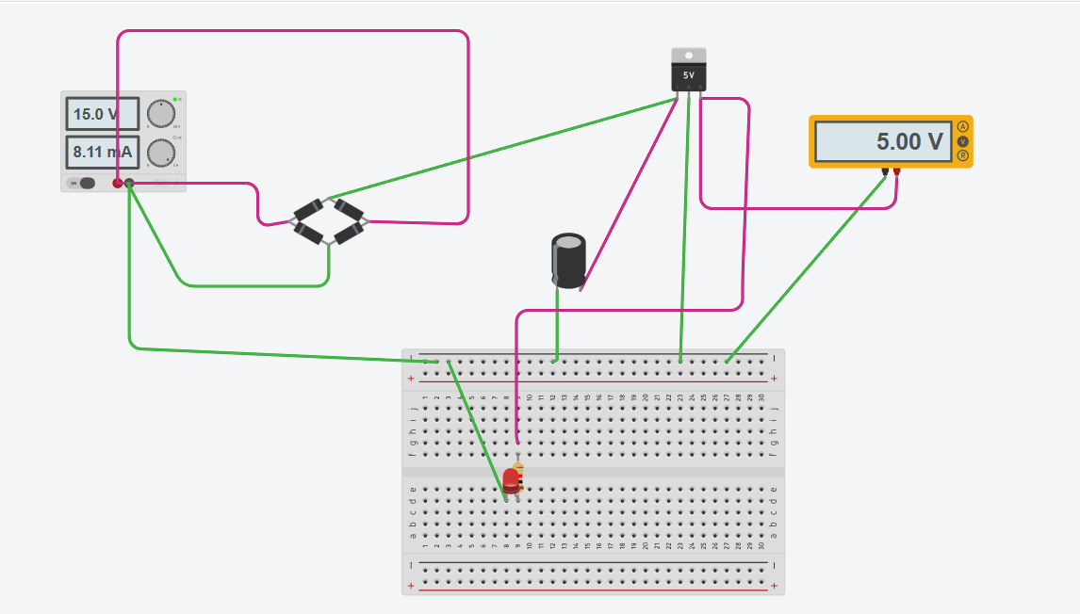
AFTER STIMULATION: Output:

Slide 12
CONCLUSION:
The completed stimulation is shown in the previous image. The circuit was tested by increasing the input voltage above 7V, which allowed the regulator to provide a stable 5V output. A multimeter confirmed the regulated voltage, and an LED was used as a visual indicator.

Slide 13
THANKYOU

